Slide 1
Why do competitors open their stores next to one another?
-Ted Talk by Jac de Haan
Notes:
A very warm Good Evening to One and All. We are Team-10.

Slide 2
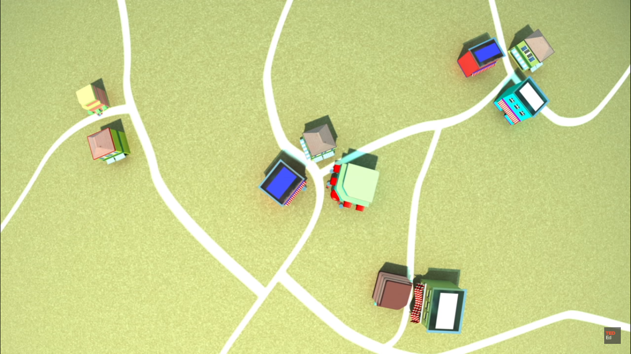
Cluster of Similar Companies
Notes:
India has a internet user-base of about 354millllion. With increasing penetratation of E-Commerce in the different fragments of the society, the market has flourished over the years. E-commerce has grown by by over 500% whereas E-retail has grown by a whopping 1400%.

Slide 3
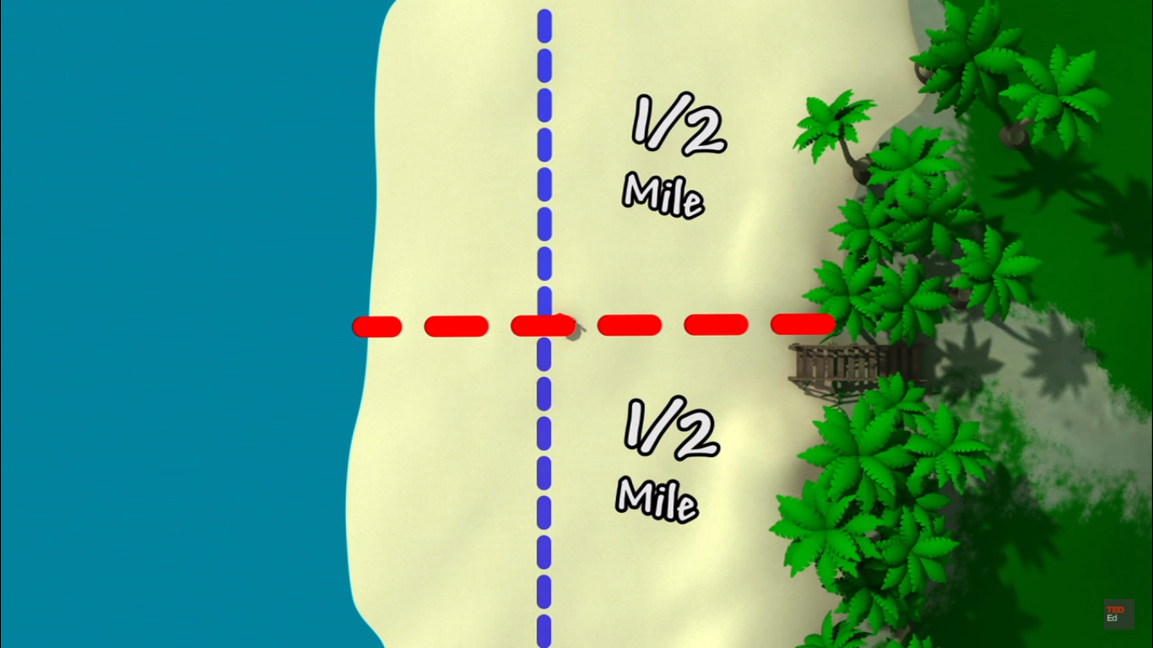
Hotelling’s model of Spatial Competition

Slide 4
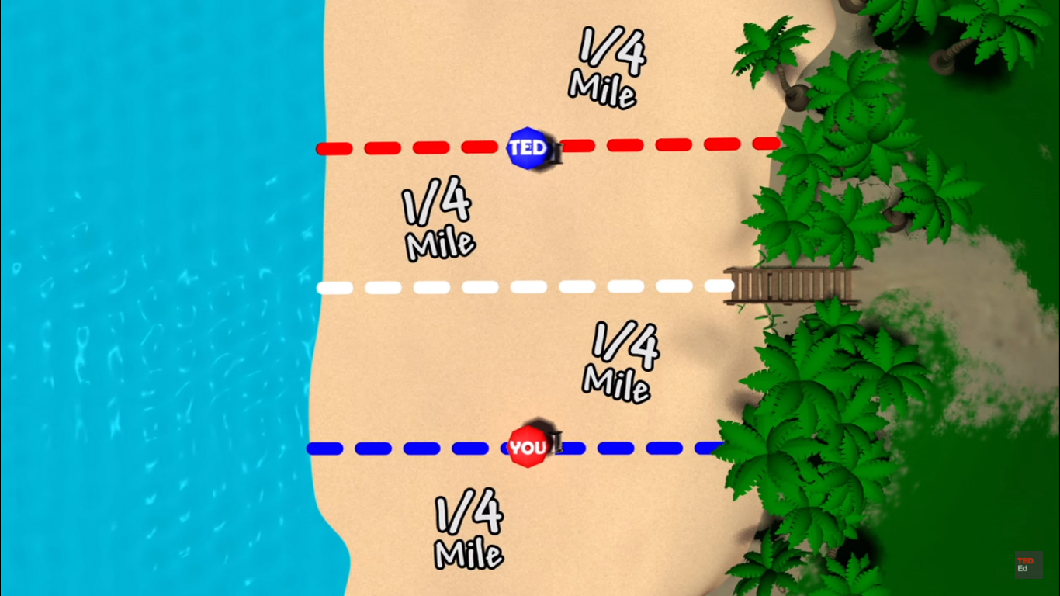
Hotelling’s model of Spatial Competition

Slide 5
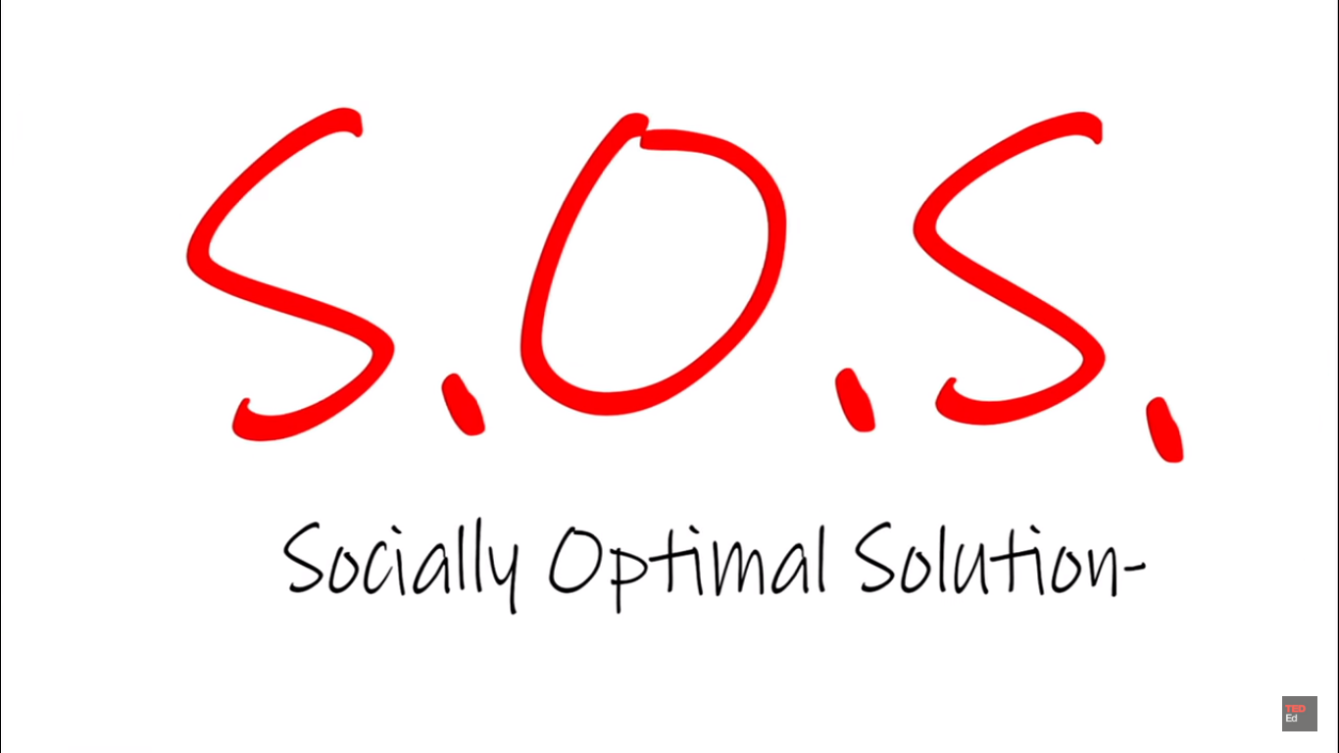
Hotelling’s model of Spatial Competition

Slide 6
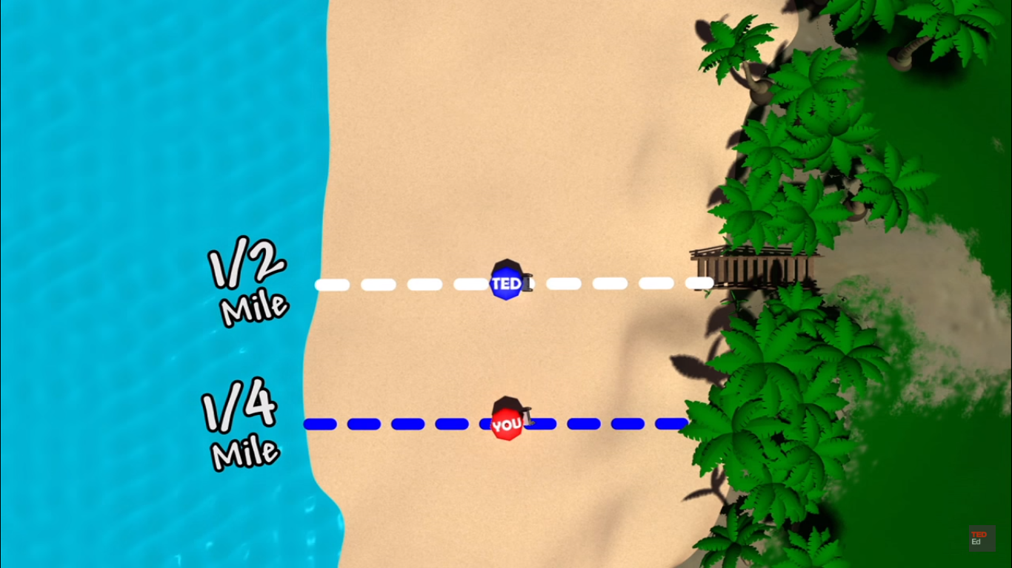
Hotelling’s model of Spatial Competition

Slide 7
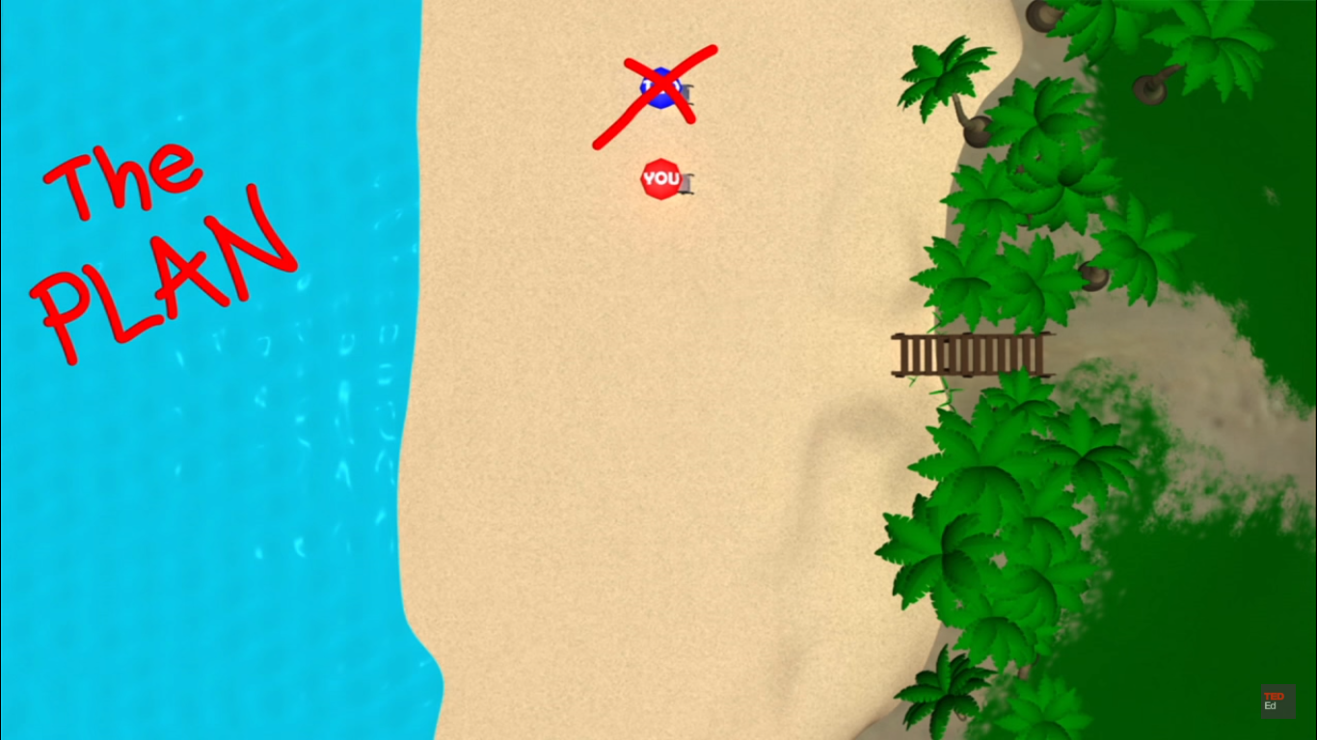
Hotelling’s model of Spatial Competition

Slide 8
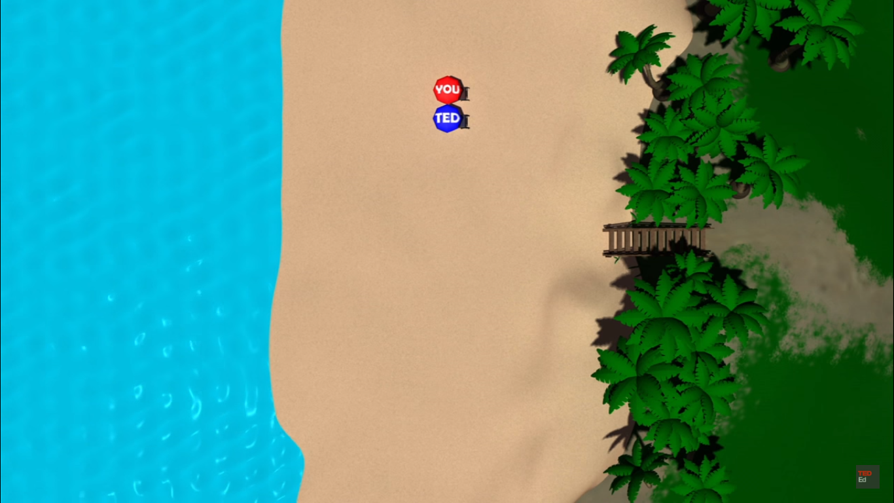

Slide 9
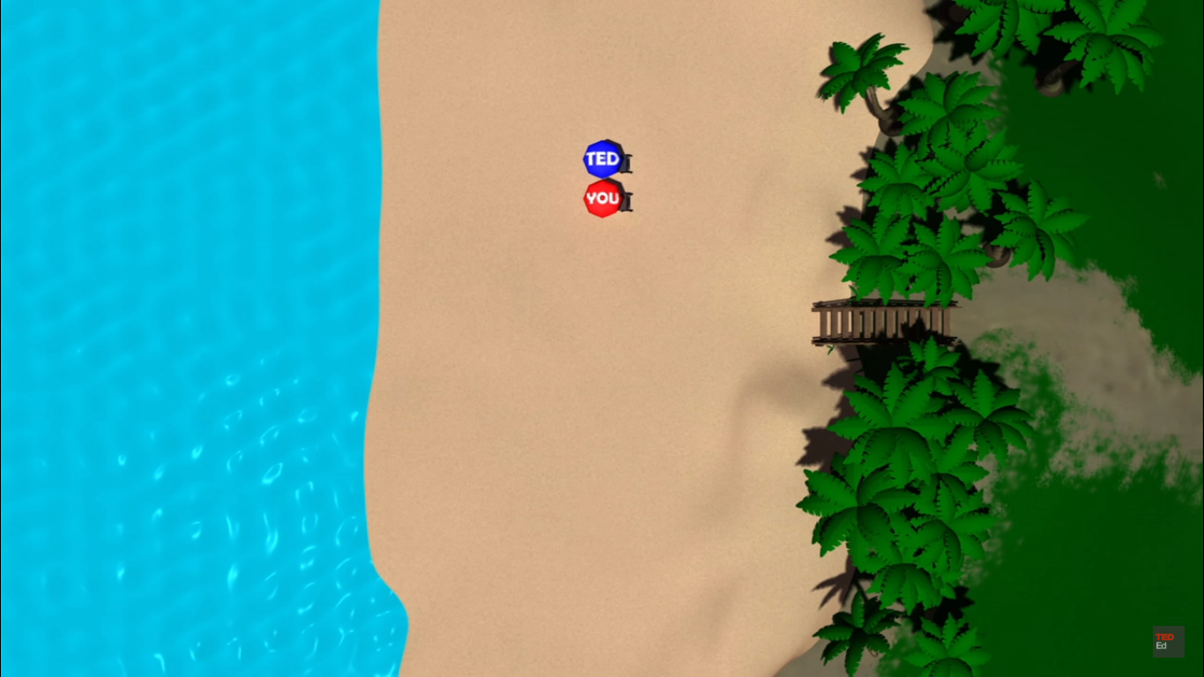

Slide 10
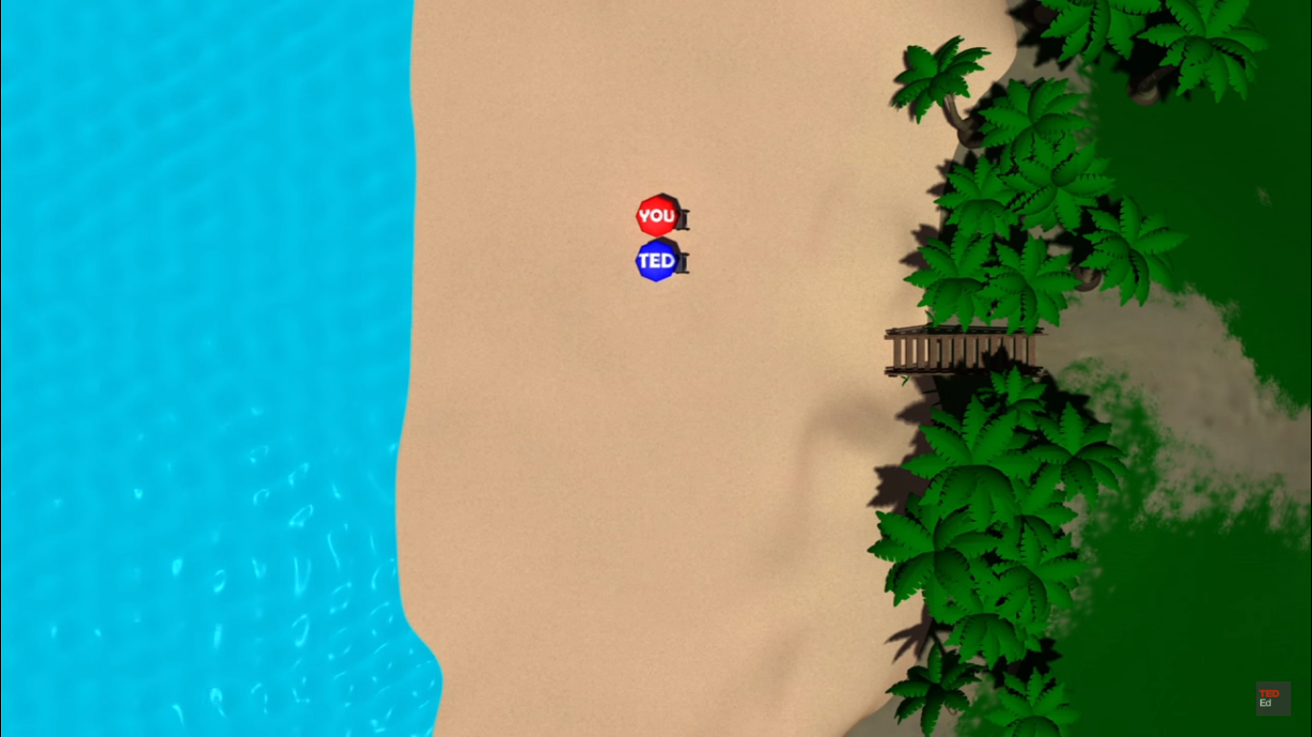

Slide 11
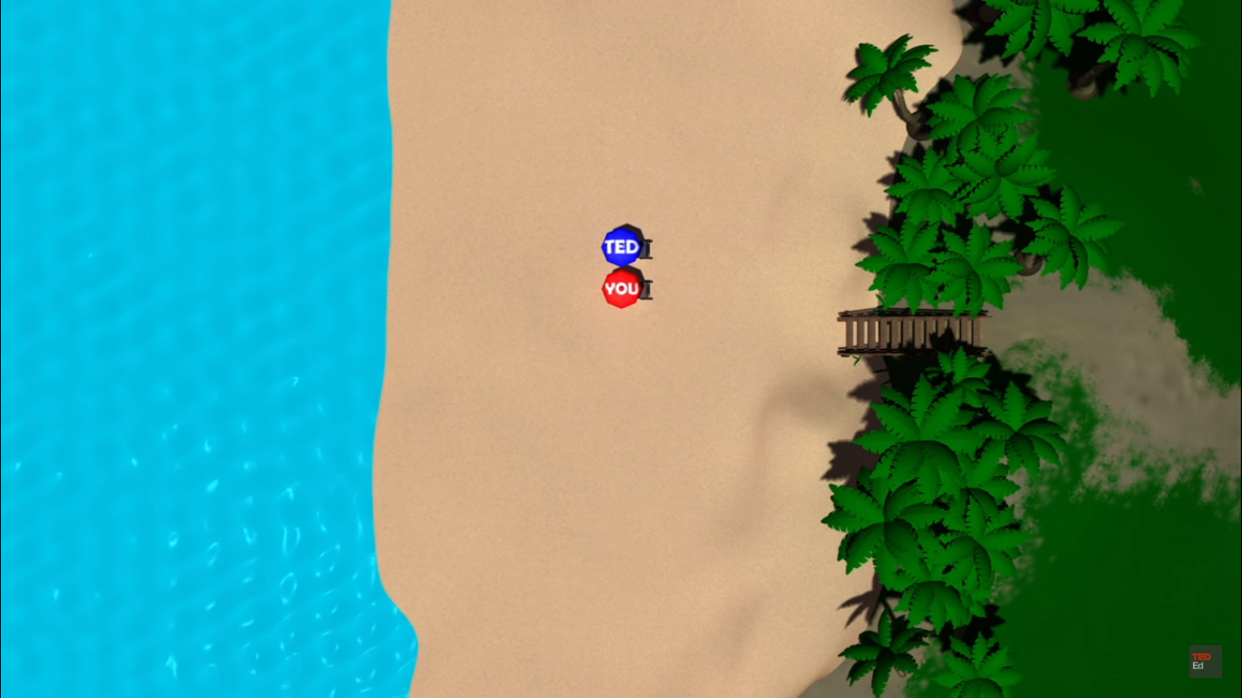

Slide 12
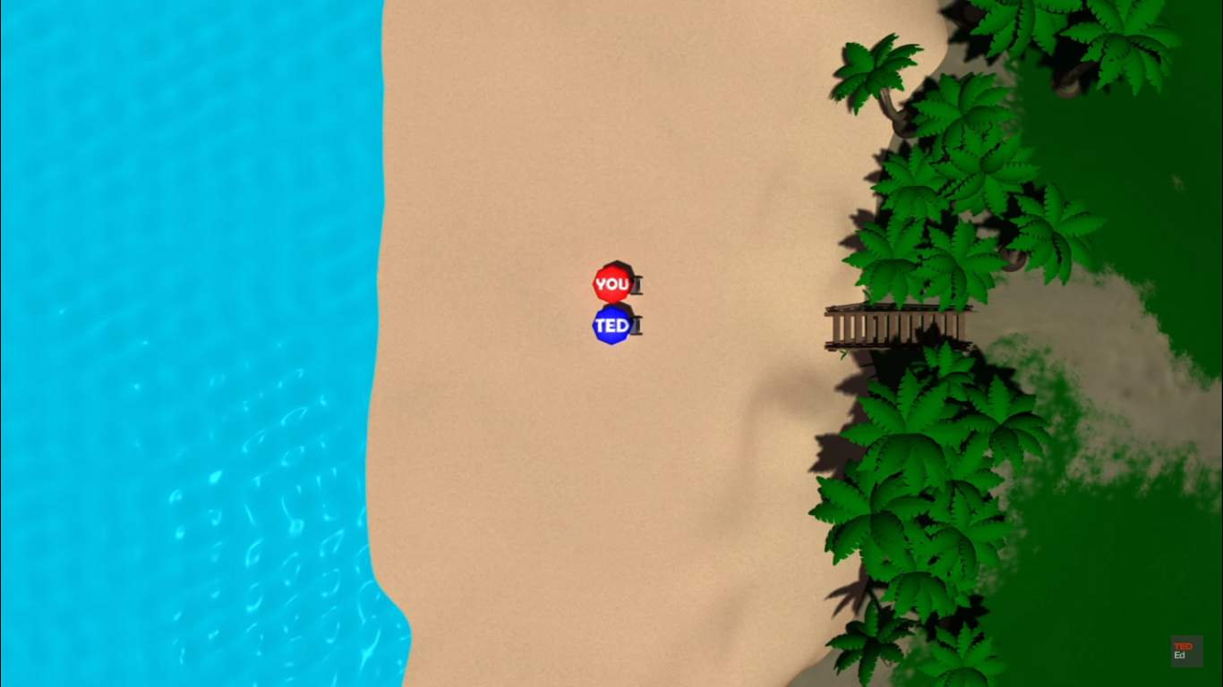

Slide 13
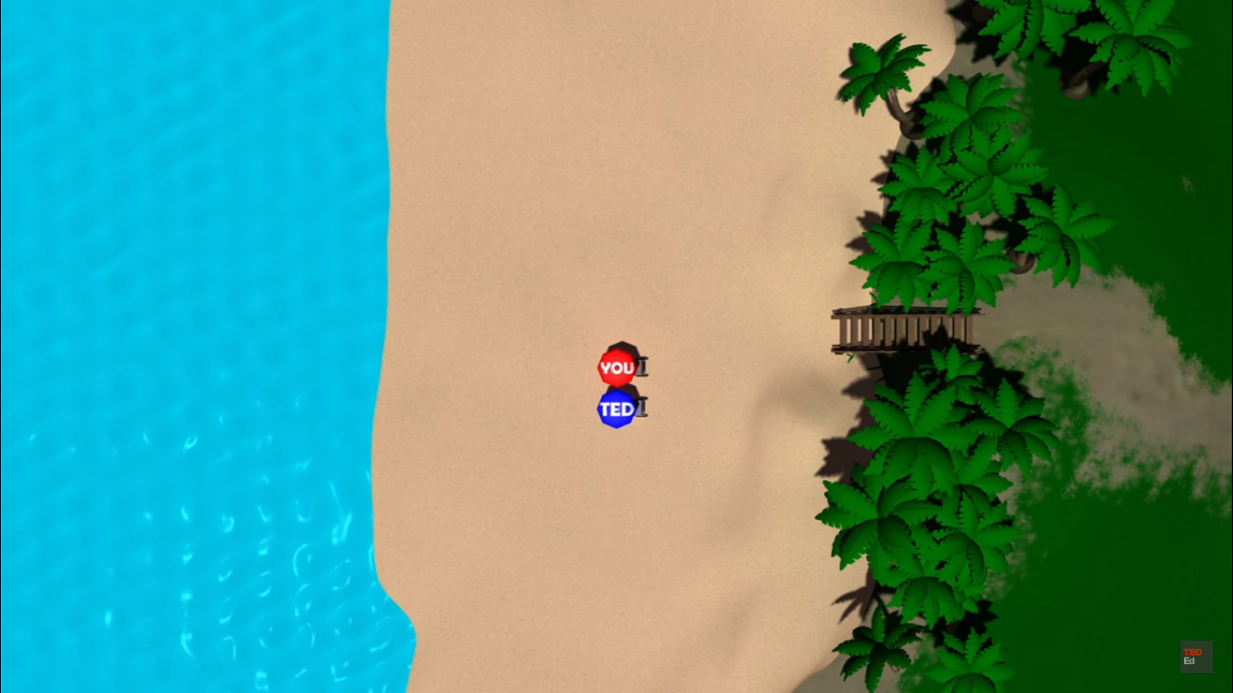
Hotelling’s model of Spatial Competition

Slide 14
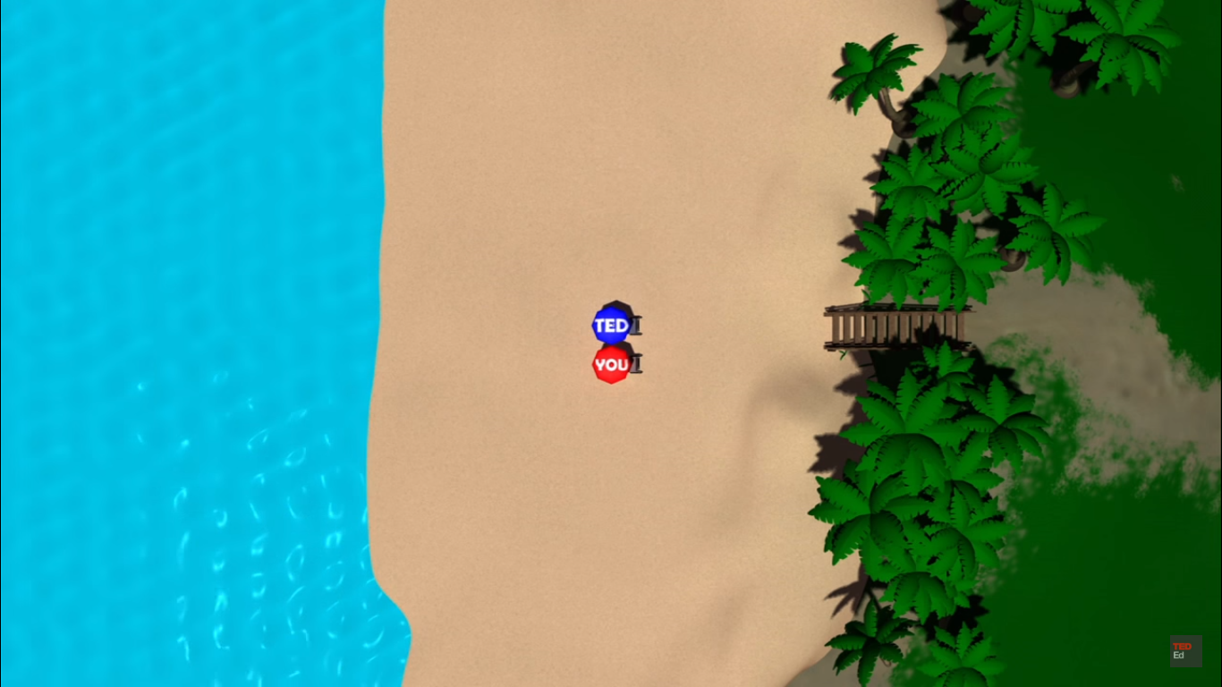
Hotelling’s model of Spatial Competition

Slide 15
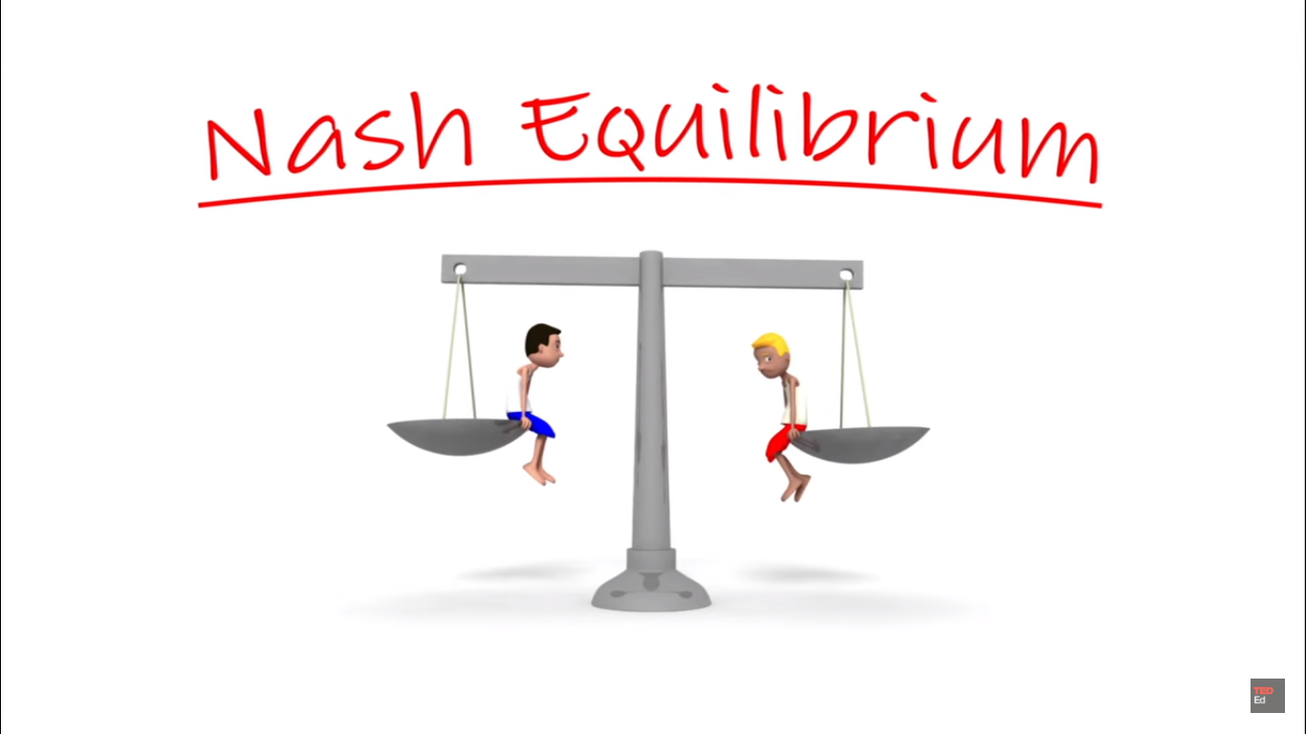
Nash Equilibrium

Slide 16
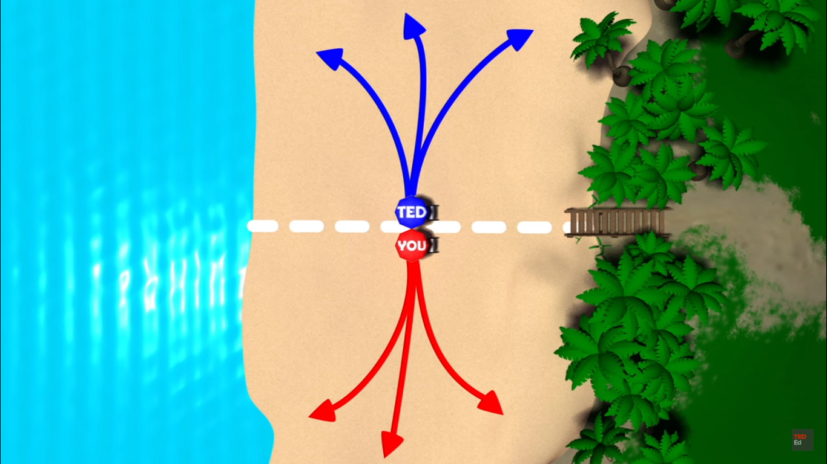
Nash Equilibrium

Slide 17
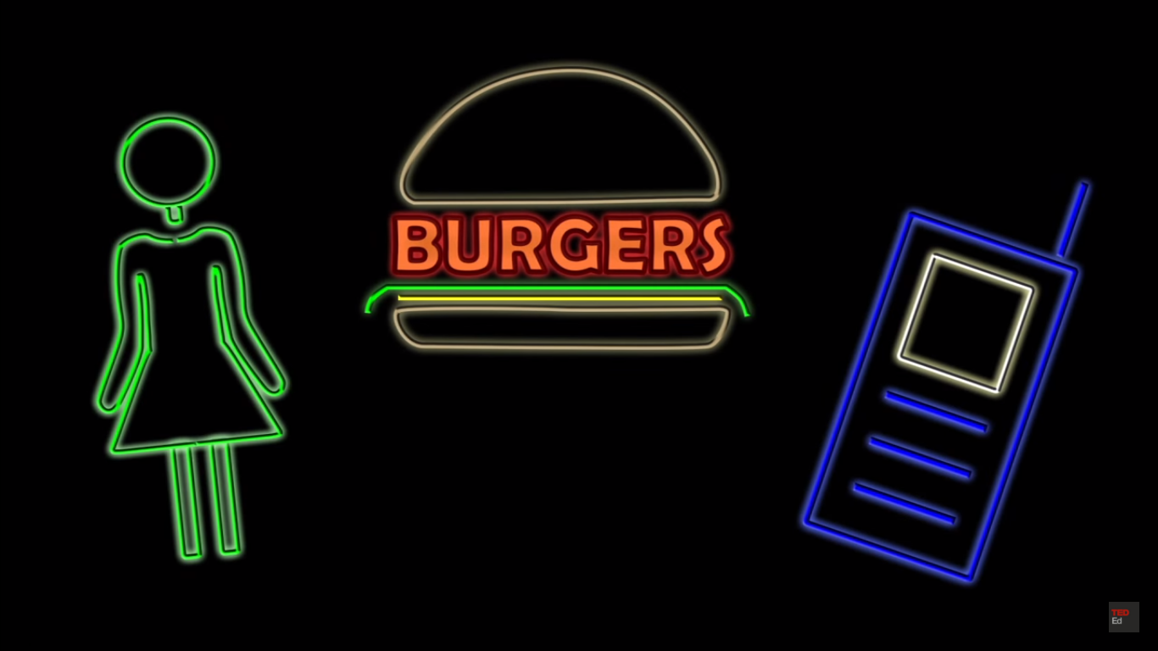
Real life Examples

Slide 18
QUESTIONS?

